Slide 1
Historiography: The History of History
A Pecha Kucha talk by Natalie Burr

Slide 2
? ? ? ?

Slide 3
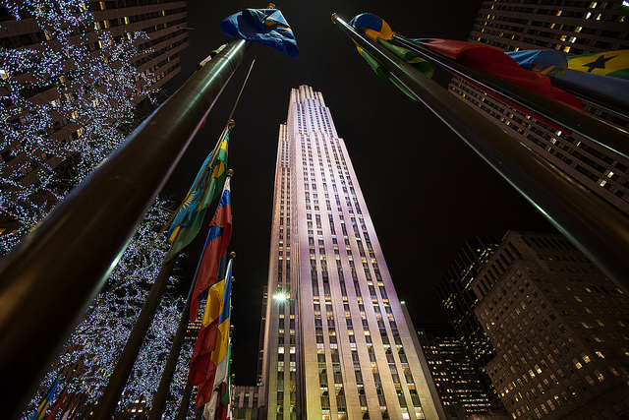

Slide 4
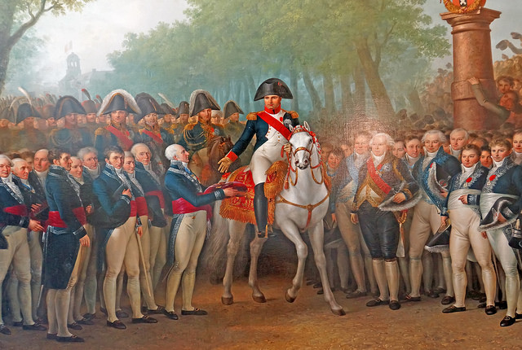
USA
VS. FRANCE

Slide 5
-How the Other Half Lives (Jacob Riis)
-Low Life (Luc Sante)
-The Jungle (Upton Sinclair)

Slide 6
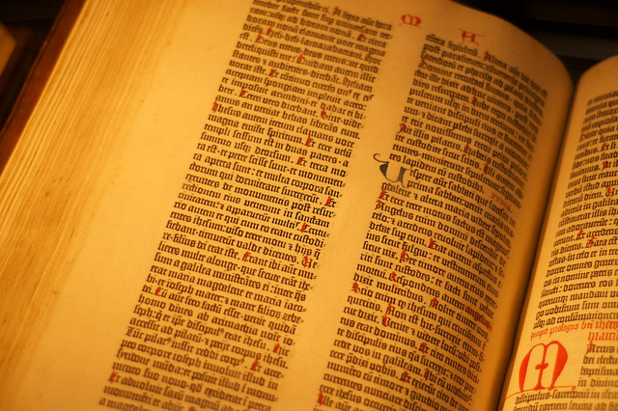

Slide 8
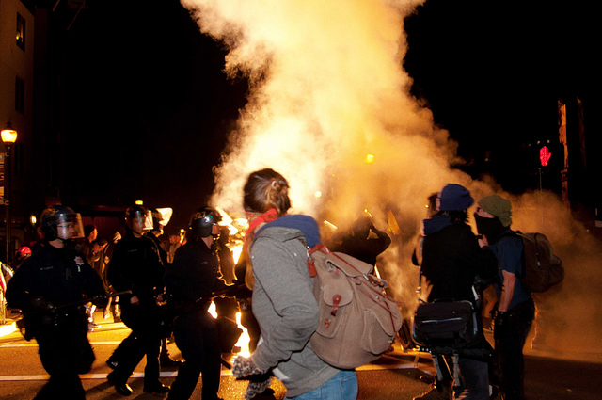

Slide 9
Wikipedia
vs.
Accurate Historical Research

